Slide 1

Work package 1:
Determinants of sex differences in health
Online meeting
13.05.2020

Slide 2




Disclaimer
The views expressed during this project are those of the authors and may not reflect the views of the funding agencies.
FutureGEN has received funding from the following funding agencies:

Slide 3
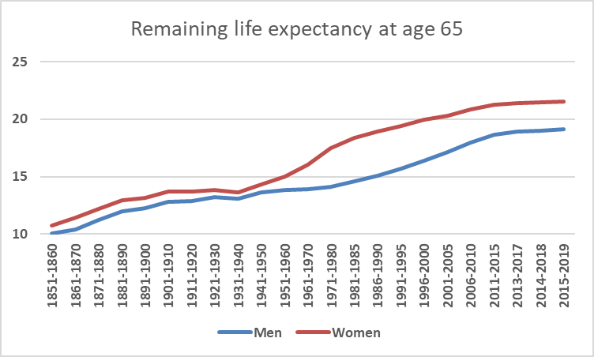
Background
(Statistics Sweden 2020)

Slide 4
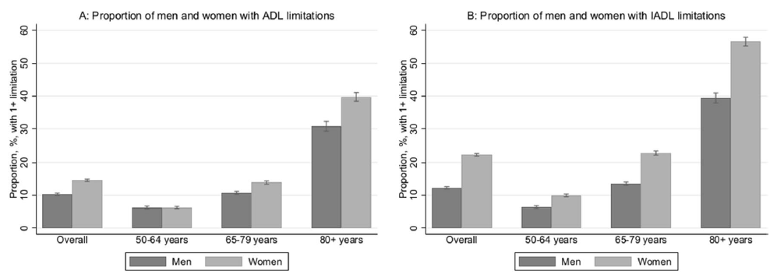
Background
(Scheel-Hinke et al. 2020)

Slide 5
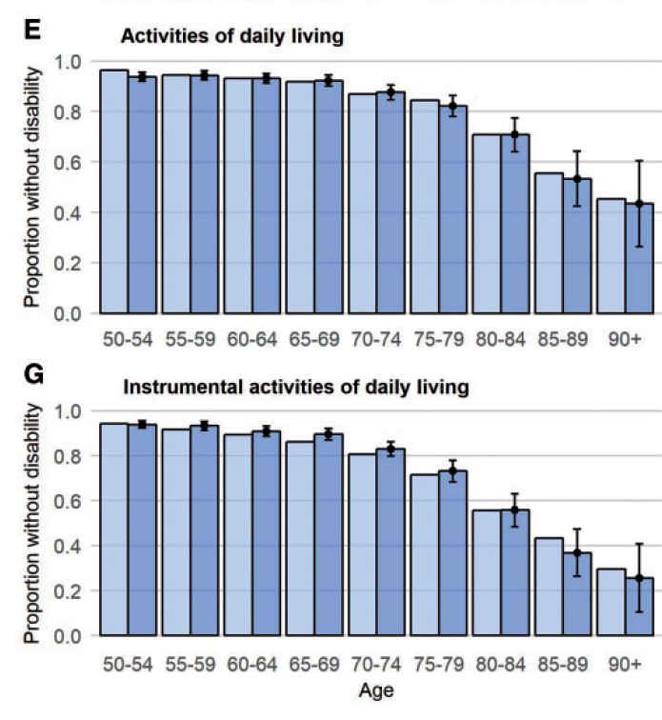
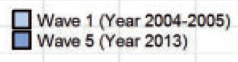
Disability trends, 2004-2013
(Ahrenfeldt et al. 2018)

Slide 6
Ongoing work
Two ongoing studies;
Study 1: A scoping review of the contribution of socioeconomic conditions to sex differences in late life disabilities.
Study 2: An empirical study of cohort differences in disability trajectories among older women and men in Europe.

Slide 7
The scoping review
The aim is to assess what the literature can tell us about the extent to which gendered differences in socioeconomic conditions can explain sex differences in disabilities and mobility impairments in later life.
Searched three databases: Medline, Web of Science & Cinahl.
Results yielded 7 555 titles, yet only six papers made it to the final analyses.

Slide 8
Main results
Most, but not all, studies revealed substantial sex differences in late life disabilities (OR: 1.5 – 5.1)
These differences could partly, but not wholly, be attributed to socioeconomic conditions.
The percentage of the sex gap that could be attributed to socioeconomic conditions ranged from null to 90%, with a median of 18% (based on 53 associations).

Slide 9
Cohort trajectories
The main aim of the study is to track disability trajectories across subsequent cohorts of older women and men in Europe
This is done using data from SHARE.
The data is analysed using multilevel growth curve models that allow us to trace the development of disabilities in five year birth cohorts.

Slide 10
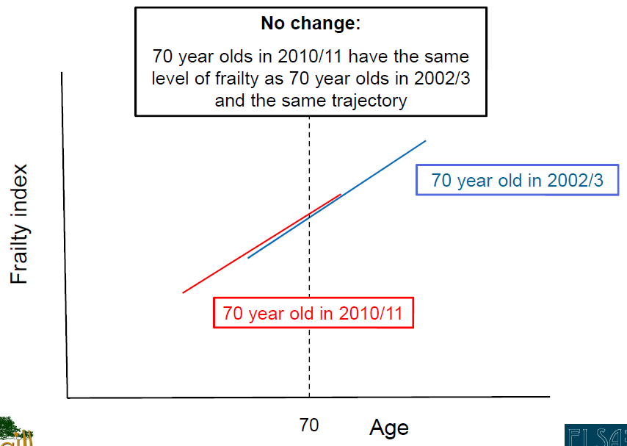
Cohort trajectories
(Nazroo 2015)

Slide 11
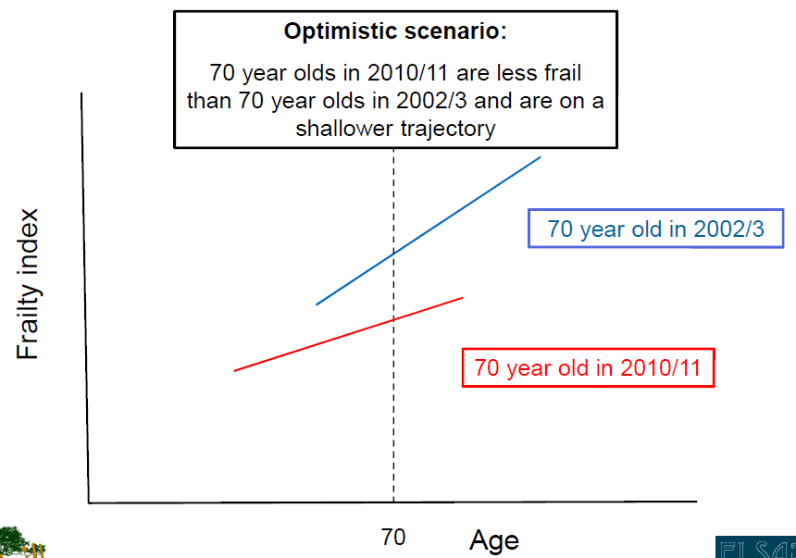
Cohort trajectories
(Nazroo 2015)

Slide 12
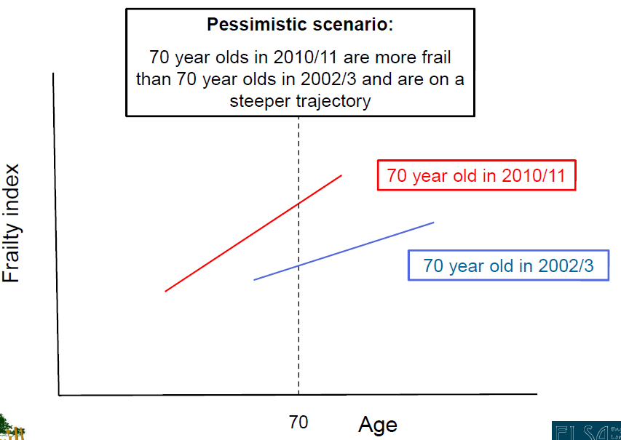
Cohort trajectories
(Nazroo 2015)

Slide 13
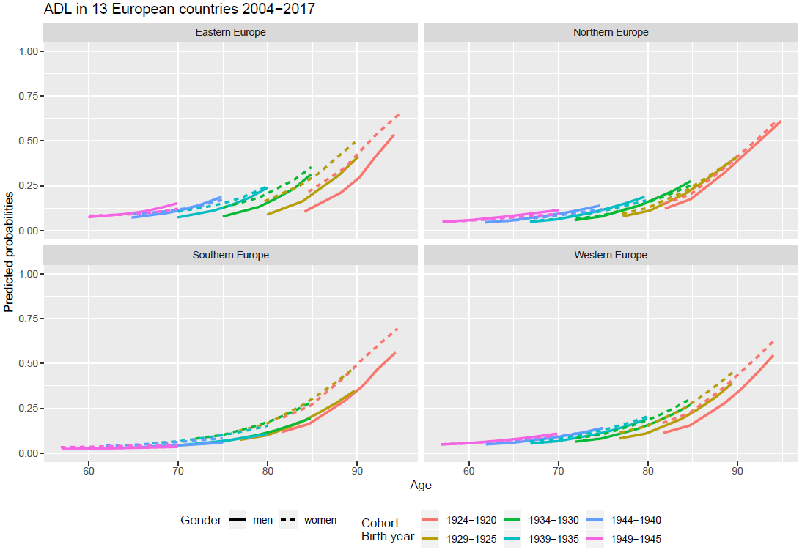
Main results

Slide 14
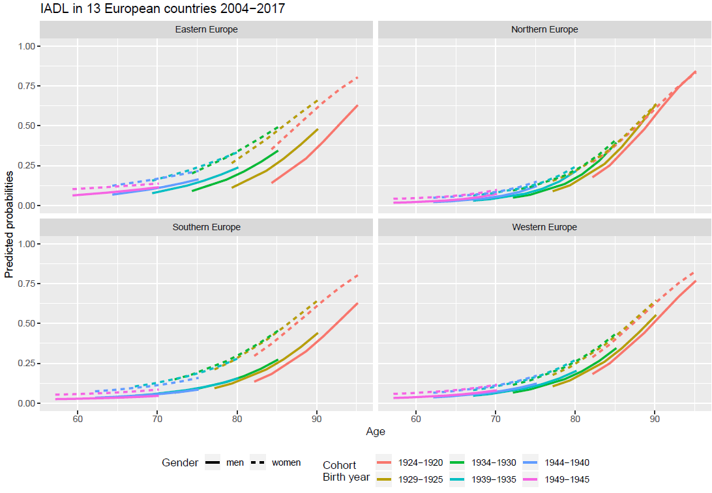
Main results

Slide 15
Conclusions
The results shows that there are considerable sex differences in the risk of late-life disabilities – but the magnitude of the disparities vary substantially across space and time.
There is some evidence suggesting that these inequalities may partly – but not wholly – be attributed to gendered socioeconomic conditions.

Slide 16
Conclusions
Later-born cohorts tended to have more disabilities than earlier cohorts.
The sex differences and cohort differences were smaller in northern Europe than in the rest of the European regions.

Slide 17
An emerging paradox?
Many previous studies have shown declining prevalence of late-life disabilities in northern Europe.
Yet, we find that later-born cohorts have more disabilities than previous cohorts, at any given age.
Is this a puzzle, or could it be attributed to compositional differences?

Slide 18
Future prospects
Finish up the two ongoing studies.
Include Canadian data in the empirical study (?)
Moving on: An empirical study of the pathways to sex differences in late-life disabilities.

