Slide 1





WP 2 Gendered care provision/ receiving
Task 2.1 How do marital status and marital stability impact (formal and informal) care receiving in old age?

Slide 2
Partnership transitions & Living arrangements
Gender specific associations for care use patterns in later life with:
  partnership transitions (particularly widowhood) and
  living arrangements (particularly living alone)
It is unclear if these are overlapping effects
Literature gap our study addresses: Are transitions out of partnership (widowhood) and living arrangements independent predictors of the probability to receive formal and informal care for both older women and men with care needs?
Notes:
Growing literature confirms gender specific associations between partnership transitions (particularly widowhood) and care use patterns in later life
Similarly, living arrangements (particularly living alone) have been consistently associated with the probability to receive informal care
It is however unclear if these are overlapping effects (i.e. widowhood affects care patterns by virtue of the changes in living arrangements it causes)

Slide 3
Sample & Methodological approach
Data from all panel waves of the SHARE survey, including:
  All individuals age 60 and above (at least at one time point in the panel)
  Have care needs (ADL, IADL, cognitive impairment) for at least two consecutive panel waves
Analysis sample: 25723 women (68.5%) & 11909 men (31.65%)
We use Random Effects Within Between models, which allow for analysis of effects between individuals (level 2) and variation over time (within individual) for different occasions on which individuals are observed
Notes:
For all time variant regressors we can estimate:
The between effect – Association between average level of a variable for each individual and care use
The within effect – Association between the change over time in a variable and ca use

Slide 4
Widowhood & living arrangements: overlapping but independent predictors
The effect of having been widowed remains significant for women but not for men, even after controlling for living arrangements
While the effect of the transition out of partnership is attenuated once we account for living alone (household size not a significant predictor)

Slide 5
Widowhood & living arrangements:
By care type
Results are confirmed in an disaggregated analysis by care type, with more marked gender differences for use of formal care services

Slide 6
Gender differences in socio-economic predictors of care use
Lower socio-economic status (measured by income and education achievement) disproportionately affects older women with care needs

Slide 7
Intersection of gender and income disadvantage in care use
Changes in income are significantly associated with the probability to receive any care type for women but not for men
  Largest effect size is observed for formal care, suggesting older women face higher financial barriers to formal care services
Women with lower education are less likely to receive formal care and more likely to rely on informal support, whereas in the case of men the association is not significant
  This effect remain significant after controlling for household size

Slide 8
We welcome your feedback on…
The framing of the research question
Through which channels can widowhood impact care use?
  We have already controlled for (i.e. living arrangements, care needs, physical and mental health)
Should we highlight any care type in particular?
  Probability to receive any care – reflects on issues of accessibility
  Probability to receive formal care – more amenable to policy intervention
  Probability to receive informal care – largest pool of care users
Which policies could be recommended to address gender gaps in the effect of low SES on care use?
  If means-testing is insufficient to address gender gaps in care use, could gender-specific eligibility criteria be introduced for subsidized formal care services?

Slide 9
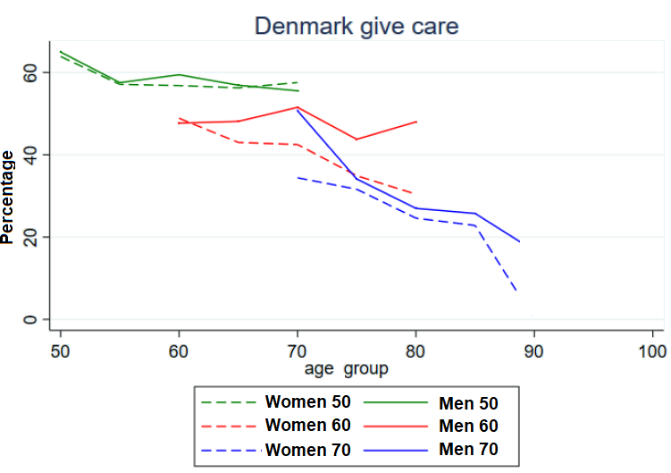
Next steps/tasks
Gender differences in informal care provision age &time
  T2.2: Trends in caregiving (Data Navigator)
  T2.3-4: Cohort analysis & country differences
Replicate for care-receiving
Source: own calculations based on SHARE

Slide 10
Thank you for your attention

