Slide 1

WP 3: review of aims, methods, results, advice
Susan Phillips
Afshin Vafaei
Queen’s University, Kingston, Canada

Slide 2




Thank you to our funders. No conflicts to declare.

Slide 3
What one looks at determines what one sees

Slide 4
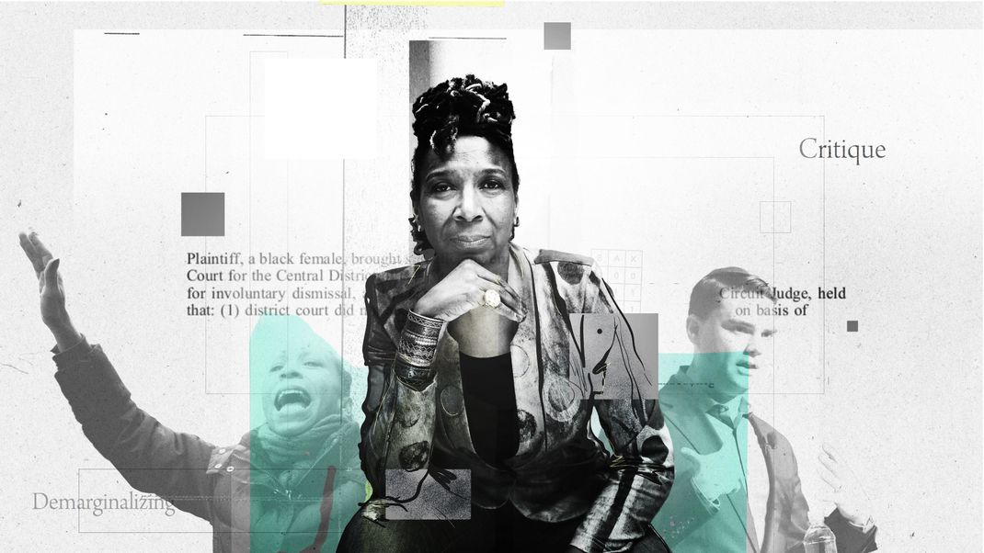

Slide 5
Intersectionality in quantitative methods
impact of differential distribution of social factors across the sexes, and;
impact of differences in the associations between such social factors and health across sexes.
Study of intersections of sex and social circumstances offers a measure of gender .

Slide 6
Methods used in studies on health among middle-aged and older adults
Aim: to inform FUTUREGEN about methods to use in assessing the impact of gender on each WP’s outcomes.
Methods: systematic review - >9000 papers, hundreds – full review

Slide 7
Results
Limited intentional exploration of intersectionality
Many control for sex
Some more elaborate methods than regression e.g. multilevel analyses, mediation, SEM, decomposition, but few considered gender
Only actual (although not potential) consistent approach for getting at gender was sex-segregation of results with whatever method was used.
Recommendation: try several methods along with sex segregation.

Slide 8
So what?
FUTUREGEN
Funders
Journals
Policy?
Gendered nature of indicators
PhD workshop

