Slide 1

FUTUREGEN
Evolving gender differences in health & care across cohorts
Sounding Board meeting
FUTUREGEN team
Vienna, 18th March 2019

Slide 2
Outline
Background: of gender, its paradoxes and changes
What we propose to do
How we propose to do it
The role(s) of the Sounding Board
2

Slide 3



The Project Team
European Centre for Social Welfare Policy and Research (AUT): Ricardo Rodrigues, Stefania Ilinca, Eszter Zolyomi
Queen‘s University (CAN): Susan Phillips, Janet Jull
Karolinska Institute (SWE): Stefan Fors, Neda Agahi
Duration: 3 years (March 2019 – February 2022)
3

Slide 4
Background
Paradoxes in health/gender: e.g. women live longer but have access to less resources
Majority of carers are women, but propensity to care changes in old-age
Paradoxes depend on how we measure them: care inside hh (male) care outside the hh (female)
Gender and sex are pervasive to these paradoxes
These paradoxes are long-standing (Arber & Ginn 1993, 1994)
Paradoxes hold at the averages, but men/women are not homogeneous
„For the times they are a-changin‘”
4

Slide 5
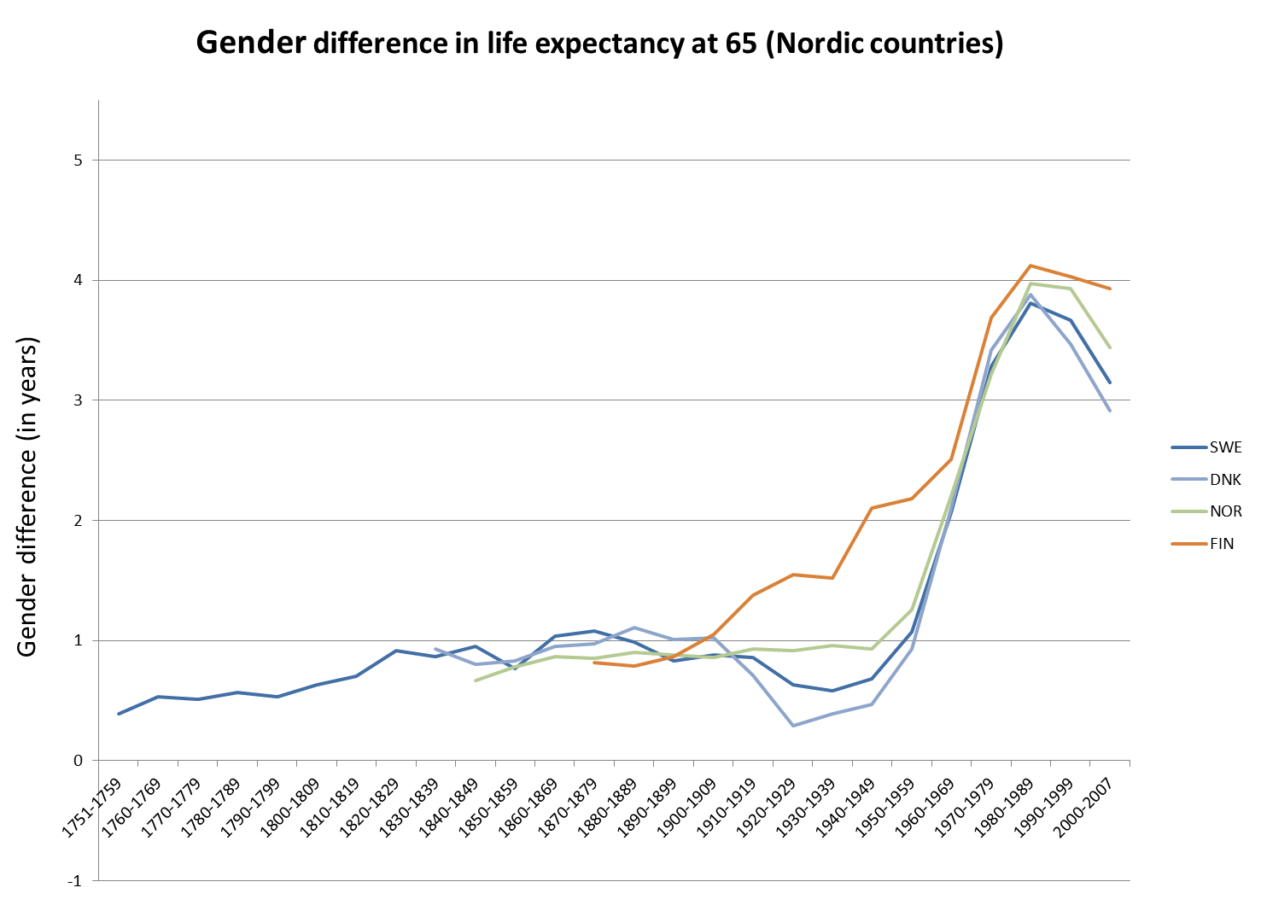
Gender differences in life expectancy – Nordic countries
(Thorslund et al., 2013)

Slide 6
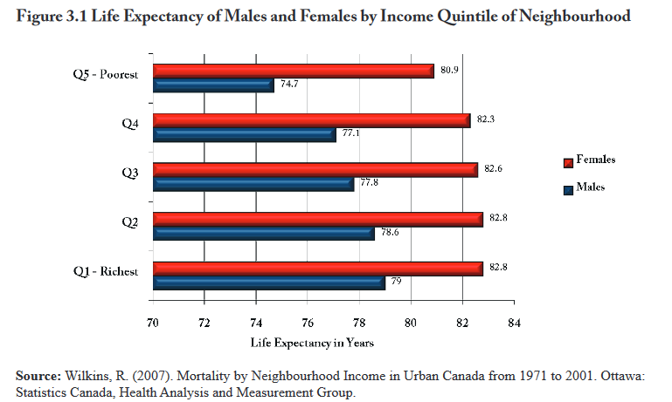
Poorest women live longer than the richest men
6

Slide 7
Background
Paradoxes in health/gender: e.g. women live longer but have access to less resources
Majority of carers are women, but propensity to care changes in old-age
Paradoxes depend on how we measure them
Gender and sex are pervasive to these paradoxes
These paradoxes are long-standing (Arber & Ginn 1993, 1994)
Paradoxes hold at the averages, but men/women are not homogeneous
„For the times they are a-changin‘”
7

Slide 8
How much care do men and women provide?
(WHO, 2018)

Slide 9
Background
Paradoxes in health/gender: e.g. women live longer but have access to less resources
Majority of carers are women, but propensity to care changes in old-age
Paradoxes depend on how we measure them
Gender and sex are pervasive to these paradoxes
These paradoxes are long-standing (Arber & Ginn 1993, 1994)
Paradoxes hold at the averages, but men/women are not homogeneous
„For the times they are a-changin‘”
9

Slide 10
SEP + Gender + Generation
Education | Stable Occurs early in life (reverse causation is less of an issue?) Behavioural or lifestyle factors in health Easily available in surveys | Lower economic returns for women with same level /years of education as men | Different social meanings in different periods (same for occupation, housing tenure) and countries (e.g. former Communist countries in Europe)
Does this measure allow enough differentiation in current (maybe also future?) cohorts of older people, and esp among women?
10

Slide 11
Background
Paradoxes in health/gender: e.g. women live longer but have access to less resources
Majority of carers are women, but propensity to care changes in old-age
Paradoxes depend on how we measure them
Gender and sex are pervasive to these paradoxes
These paradoxes are long-standing (Arber & Ginn 1993, 1994)
Paradoxes hold at the averages, but men/women are not homogeneous
„For the times they are a-changin‘”
11

Slide 12
WHAT we set ourselves to do: aims
To do research that will:
examine how GENder inequalities in health (Objective 1) and care-giving/receiving (Objective 2) have evolved across GENerations in relation to changing contexts and life choices
study how in the FUTURE associations between contexts and life choices and GENder inequalities in health (Objective 3) and care (Objective 4) may evolve
disentangle how interactions among social factors including gender and Socio-Economic Position (SEP) alter health and care-giving/receiving (Objective 5)
determine how to minimize gender bias embedded in health and care research by carefully considering gendered meanings of measures and methodologies used (Objective 6)
12

Slide 13
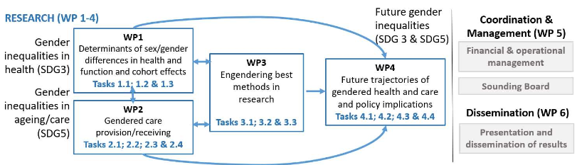
HOW we set ourselves to do it: WPs
Objective 1
Objective 6
Objective 3 & 4
Objective 2
Objective 5
13

Slide 14
Paradigms underpinning FUTUREGEN
Social determinants of health
Income and social status, Employment and working conditions, Education and literacy, Childhood experiences, Physical environments, Social supports and coping skills, Healthy behaviours, Access to health services.
Life course perspective: place&time (context), pathways (cumulative), timing of events (contingencies), social relations (linked lives)
Intersectionality: heterogeneous, no simple adding up of characteristics
14

Slide 15
Deliverables
9 peer-reviewed articles
5 Policy Briefs (6 pages) in English, French, German and Swedish
a methods manual for researchers and statistical offices
PhD workshop
time-series on health inequalities among the old, across cohorts&countries
time-series on care-giving/receiving for old across cohorts&countries
data on distribution of health resources among current and future cohorts of older adults
Metadata and routines for data harmonization and calculation
FUTUREGEN’s
DATA
NAVIGATOR
15

Slide 16
The role(s) of the Sounding Board
Identify policy relevance
Inputs for decisions
Actively participate in the research... HOW?
  Comment on early findings or research articles
  Co-author articles or/and policy briefs
  Inputs (e.g. data) and outputs (e.g. indicators, policy briefs)
Ensure adequate language
Develop end-of-grant plan
16

Slide 17
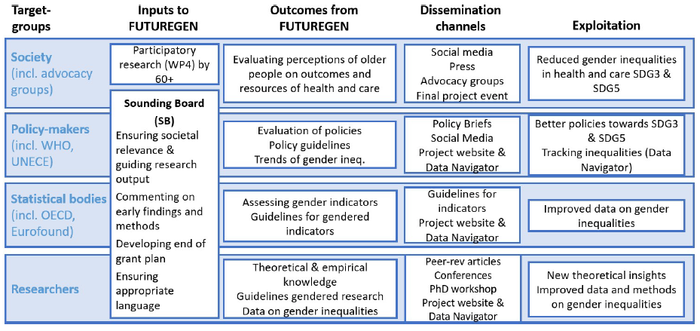
Impact of FUTUREGEN
17

Slide 18
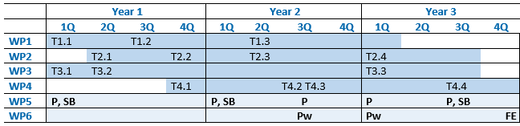
How are we going to work together? Timeline
March 2019
December 2019
December 2020
December 2021
February 2022
18

